Slide 1
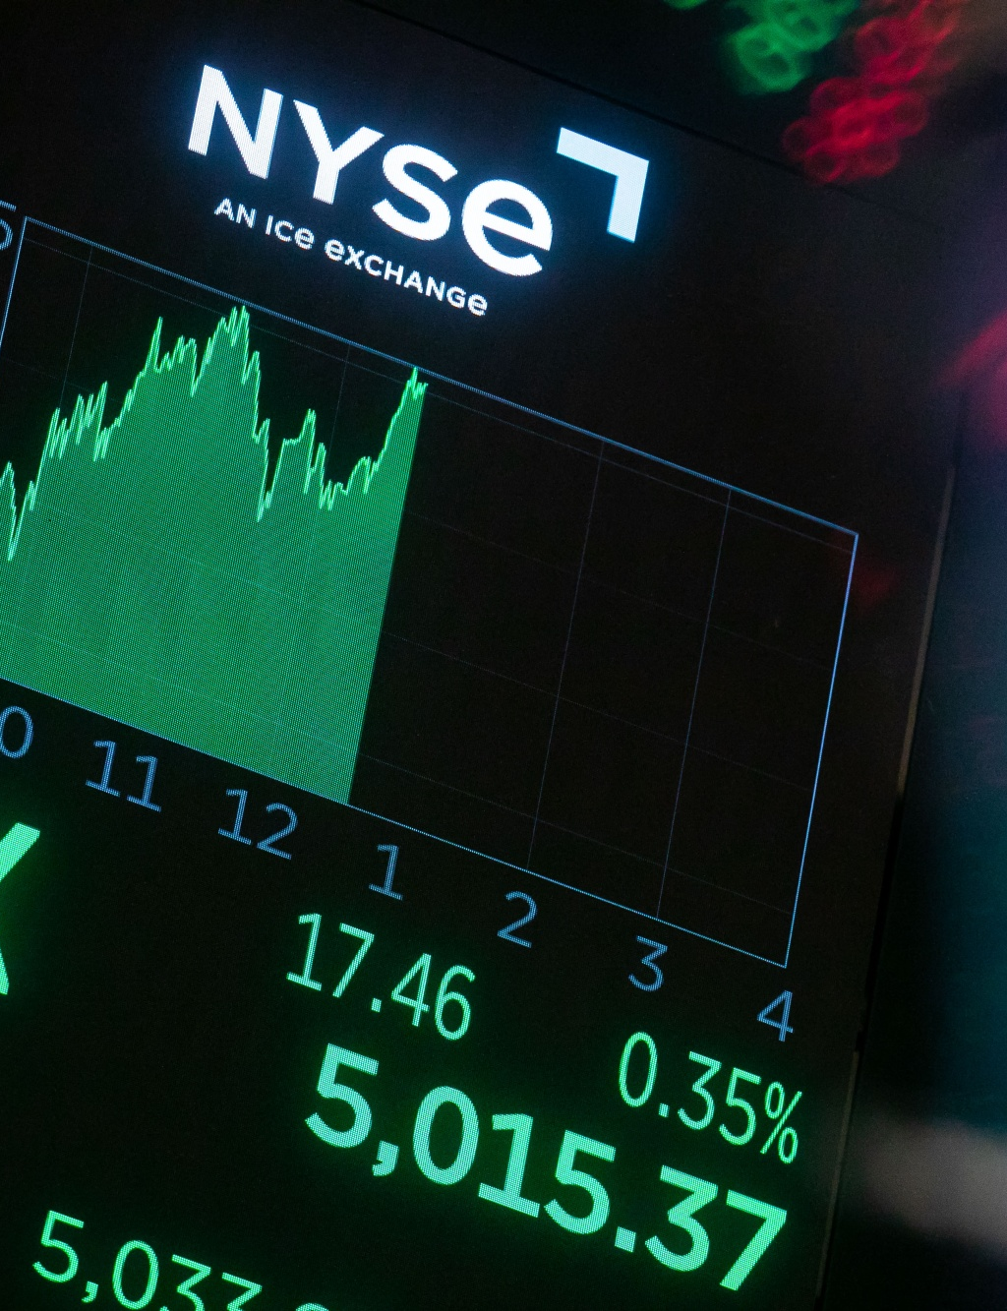

MATH 448 - Introduction to Statistics and Machine Learning
Model to Predict Stock Price

Slide 2
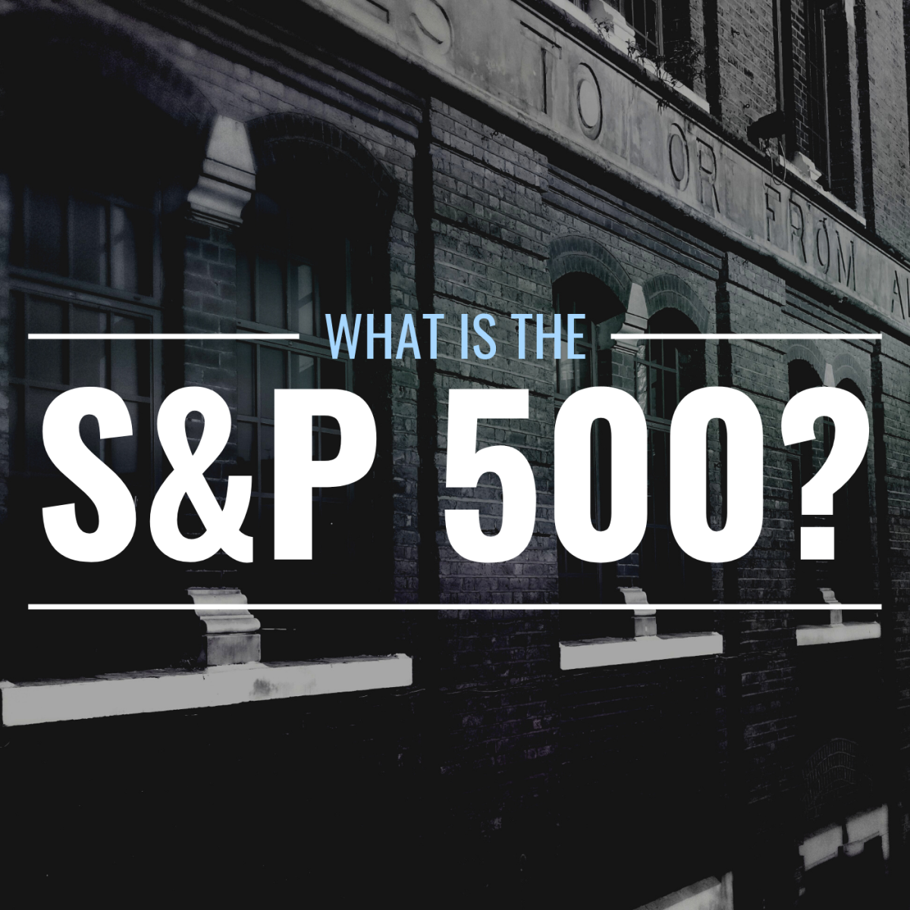
Understanding
The S&P 500
The Standard & Poor's 500, commonly referred to as the S&P 500, is an index comprising 500 of the largest publicly traded companies in the U.S. It is designed to be a leading indicator of U.S. Equities.
Why is it important?
Market Indicator: The S&P 500 is widely regarded as the best single gauge of large-cap U.S. equities.
Economic Indicator: It reflects the health of the U.S. economy and investor sentiment towards market conditions.
Investment Benchmark: Many investment funds and individual portfolios measure their performance against the S&P 500.

Slide 3

Goal
The objective of this project is to develop machine learning model capable of predicting future stock prices (next day stock price) of companies listed in the S&P 500 index.
How -
Utilizing historical data, the models will be trained on various features such as date, S&P 500 index values, adjusted closing prices, Market cap, EBITDA and other relevant metrics. The aim is to enable the model to identify patterns and relationships within the data, thereby forecasting future price movements with accuracy. This project will not only provide insights into the predictive capabilities of machine learning in financial markets but also aid in making informed investment decisions.

Slide 4
Data Overview
sp500_companies
sp500_index
sp500_stocks
Three data sets from Kaggle are used
01
02
03
df_company = Company metadata for S&P 500 companies.
df_index = S&P index value each day
df_stocks = Individual stock features such as Date, Symbol, Adj Close, Close, High, Low, Open
https://www.kaggle.com/datasets/andrewmvd/sp-500-stocks?resource=download

Slide 5
Data Overview
sp500_companies
sp500_index
sp500_stocks
01
02
03
# Column Non-Null Count Dtype --- ------ -------------- ----- 0 Exchange 503 non-null object 1 Symbol 503 non-null object 2 Shortname 503 non-null object 3 Longname 503 non-null object 4 Sector 503 non-null object 5 Industry 503 non-null object 6 Currentprice 503 non-null float64 7 Marketcap 503 non-null int64 8 Ebitda 474 non-null float64 9 Revenuegrowth 501 non-null float64 10 City 503 non-null object 11 State 483 non-null object 12 Country 503 non-null object 13 Fulltimeemployees 495 non-null float64 14 Longbusinesssummary 503 non-null object 15 Weight 503 non-null float64
# Column Dtype --- ------ ----- 0 Date object 1 Symbol object 2 Adj Close float64 3 Close float64 4 High float64 5 Low float64 6 Open float64 7 Volume float64
# Column Non-Null Count Dtype --- ------ -------------- ----- 0 Date 2518 non-null object 1 S&P500 2518 non-null float64

Slide 6
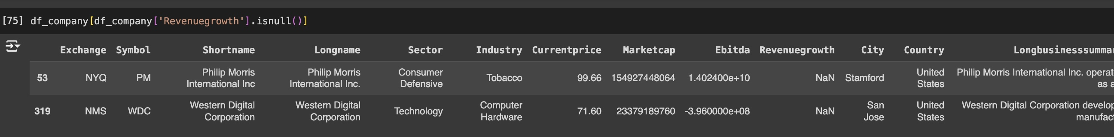
Data cleaning and Pre-processing
Based on the info of dataframes df_company has below columns with null rows - Revenue growth, State & , Fulltimeemployees.
Dropping fields - Dropping 'State', 'Fulltimeemployees' fields entirely. I am not going to use "State" and "Fulltimeemployees" column for future stock price prediction.
Adding data - Revenue growth for Western Digital Corporation and Philip Morris International Inc. is missing I have added this data to the dataframe from https://stockanalysis.com

Slide 7
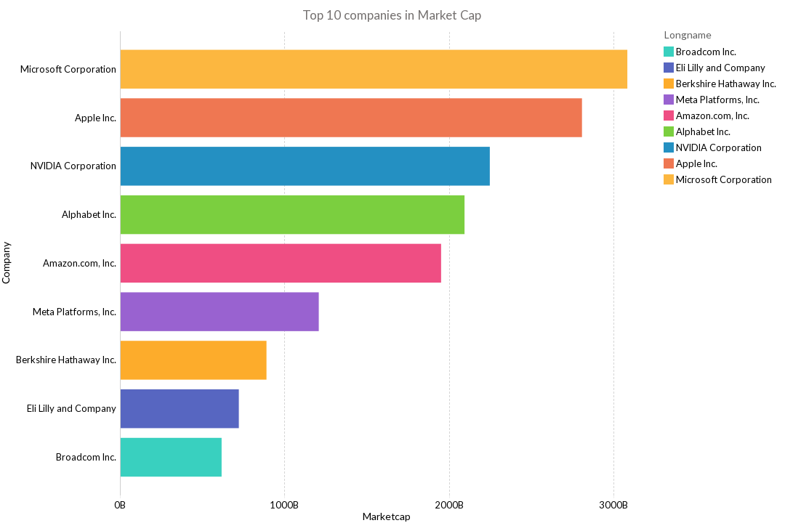
Data Visualization
Top 10 companies in Market Cap
Top 10 Companies in Market Cap
Top 10 companies in market cap we sort the data by market cap. Market cap is calculated by multiplying the current stock price by the total number of outstanding shares. Helps us understand which is the largest company in S&P 500. Currently Microsoft is Largest in Market Cap.

Slide 8
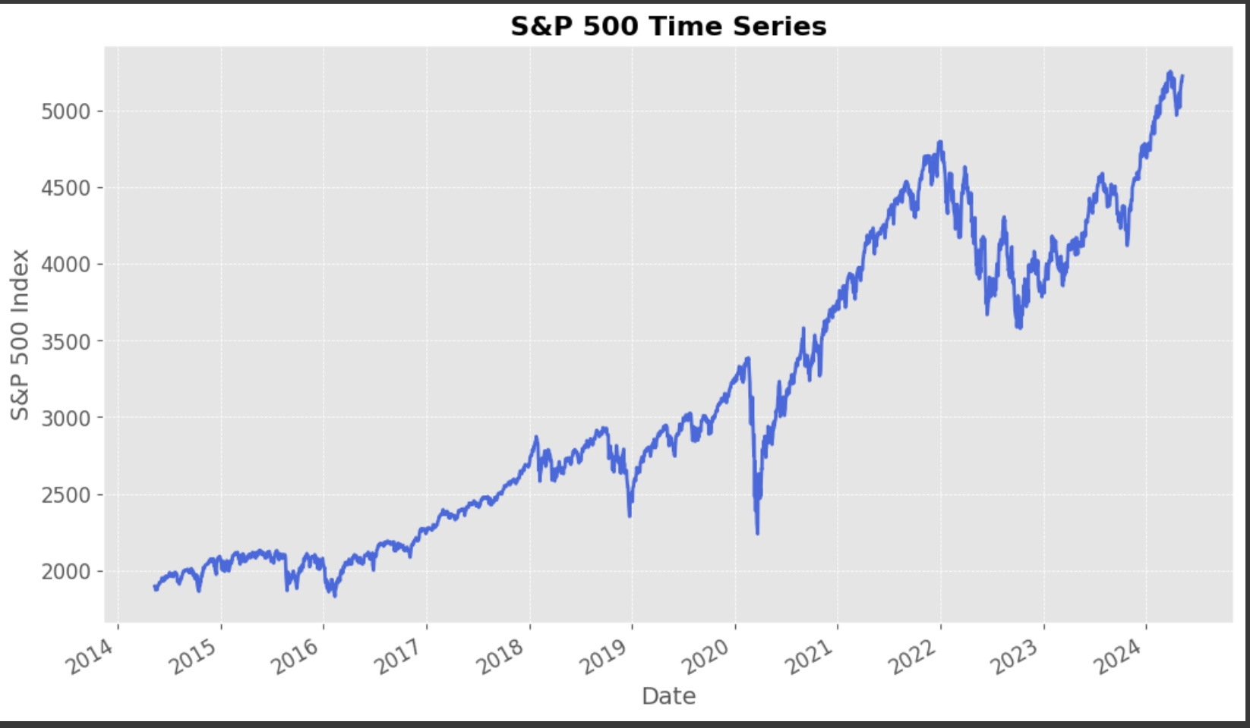
Data Visualization
Top 10 companies in Market Cap
Time series chart of S&P 500
Plotting a time series chart of the S&P 500 index provides a visual representation of the historical performance and trends of the stock market.

Slide 9
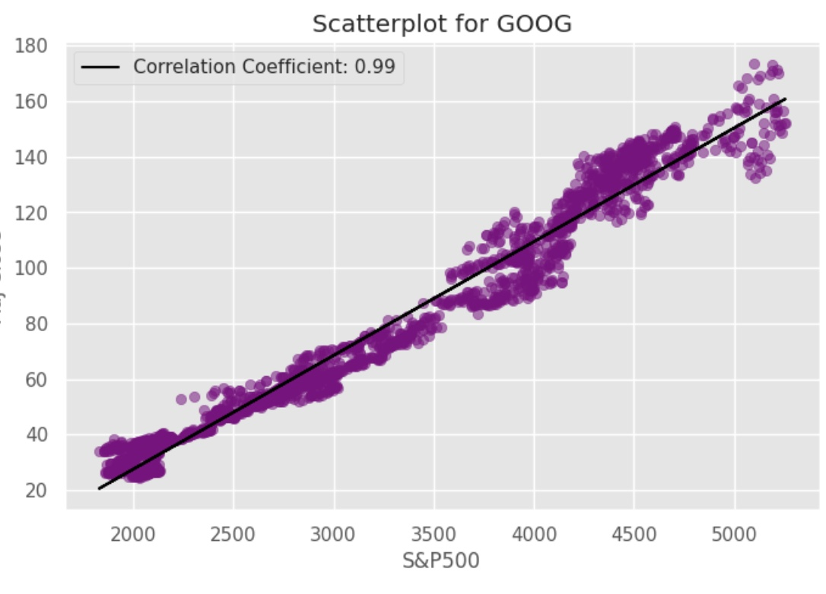
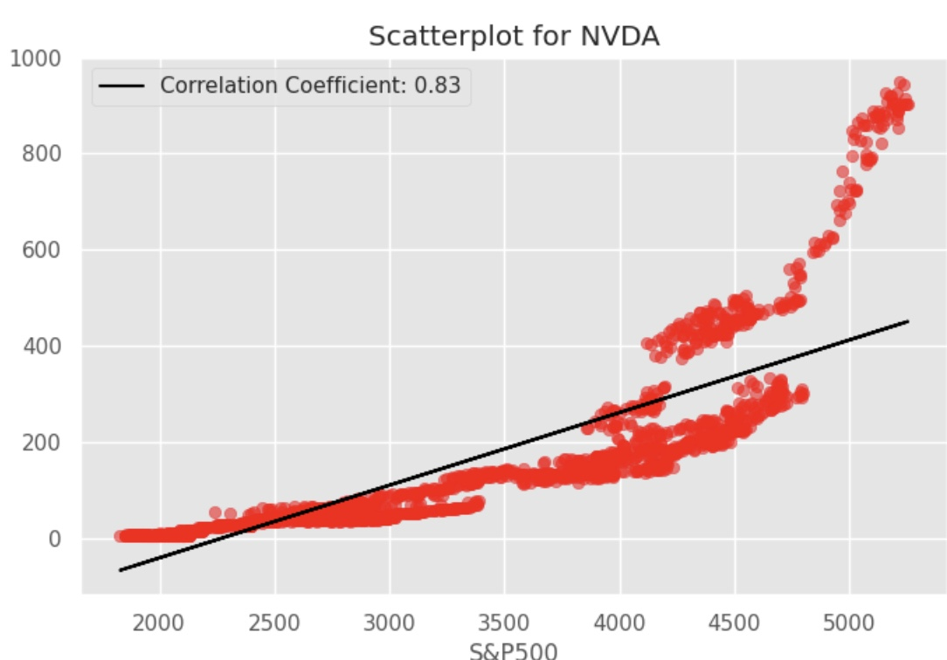
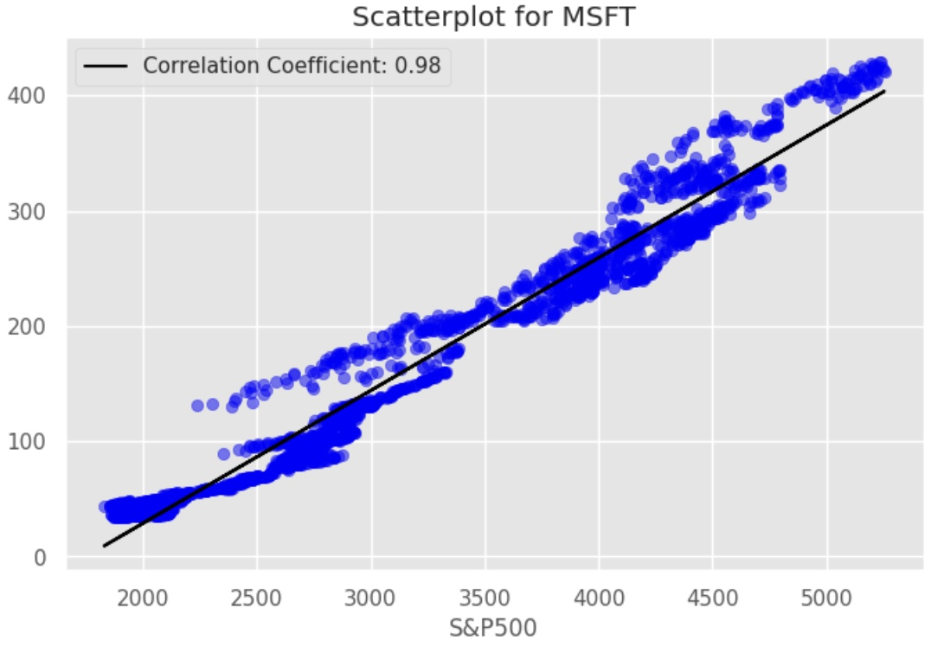
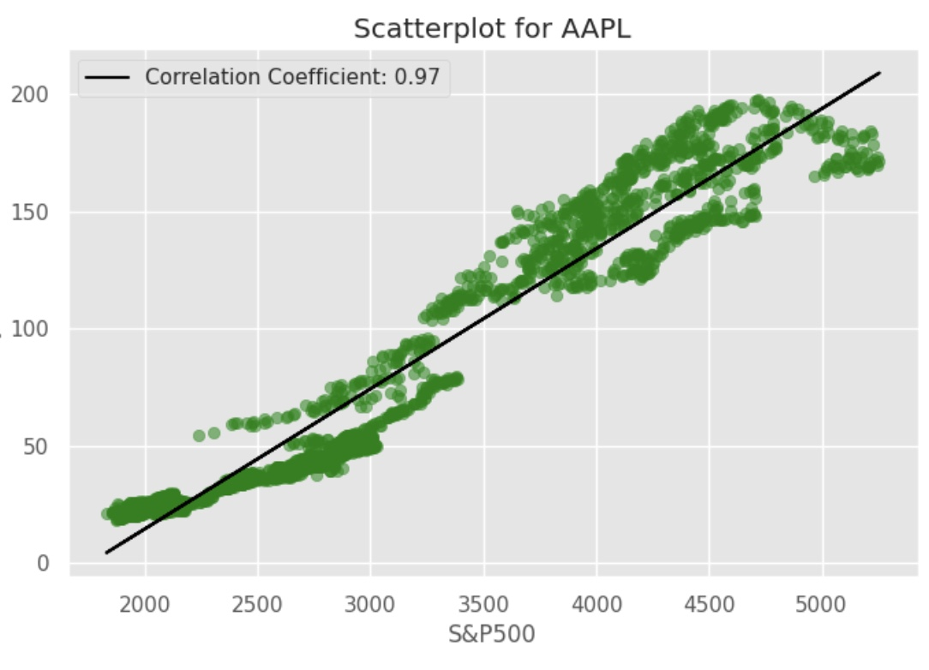
S&P 500 and its top 10 companies
The correlation between the S&P 500 and its top 10 companies by market capitalization shows how closely the index tracks the performance of these major players. When the top 10 companies experience price changes, it tends to influence the overall movement of the S&P 500 index.
Symbol | Correlation Coefficient
GOOG | 0.985745
GOOGL | 0.985216
MSFT | 0.983761
AAPL | 0.968562
BRK-B | 0.964057
AMZN | 0.914597
AVGO | 0.897557
META | 0.860915
LLY | 0.842416
NVDA | 0.831708
Scatterplot for Nvidia - Least correlation
Scatterplot for Google - Highest correlation
Scatterplot for Apple - Higher correlation
Scatterplot for Microsoft - Higher correlation

Slide 10

Machine Learning Models
Data Preparation and Cleaning
Feature engineering
Data Scaling and splitting
Model Training and Evaluation
To perform stock price prediction using machine learning models like linear regression, Lasso, Ridge. I have done it in steps.

Slide 11
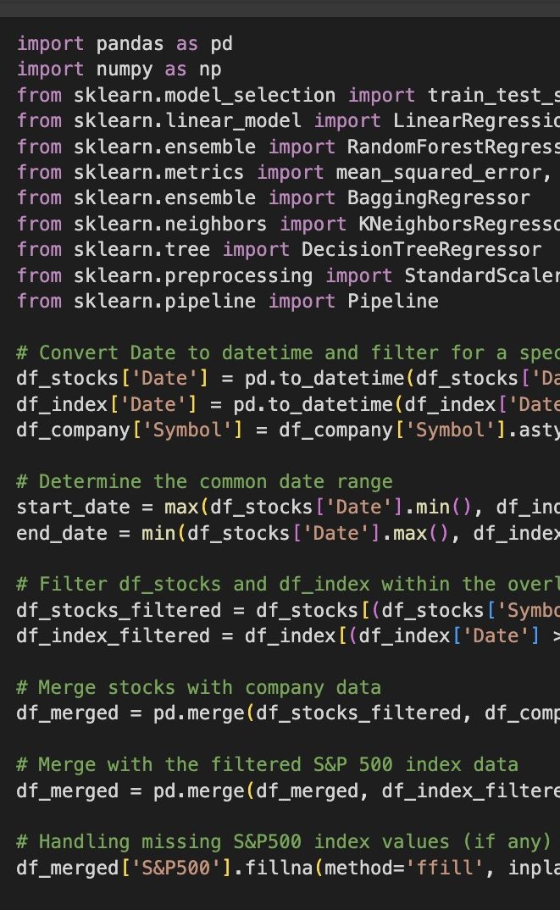
Data Preparation and Cleaning
Date Conversion - Date columns in the stock and index dataframes are converted to datetime objects for time series.
Eliminating NA's - Since df_index data has dates starting from 2010 and df_stocks has dates starting from 2014 i have eliminated the additional dates in df_index.
Stock Symbol Selection - While selecting the stock symbol, i have Chossen Microsoft. As it is the company with highest market cap and higher correlation
We can select any company from the S&P 500 list and run the model

Slide 12
Feature Engineering
Percentage Change
Market_cap to EBITDA Ratio
Digital Marketing
S&P 500 Index
Moving Average Convergence Divergence(MACD)
Volatility
Moving Average and Standard deviation
The Moving averages and standard deviations over 20-day and 5-day is used to account for short-term and medium-term trends and volatility.
It computes the daily change in stock price as percentage change, providing a measure of daily price movement.
The MCap_EBITDA_Ratio is calculated, which is useful to find the value of the company relative to its earnings before interest, taxes, depreciation, and amortization.
This is used to capture the impact of movement in S&P 500 on stock price of the chossen company
The 26-day and 12-day Exponential moving average (EMA) are used to compute the Moving Average Convergence Divergence (MACD), an indicator to help identify price trends, measure trend momentum, often used to gauge the momentum of stock prices.
Measures the volatility over a 30-day window as the ratio of the standard deviation to the mean of 'Adj Close', providing a normalized measure of price variability.

Slide 13
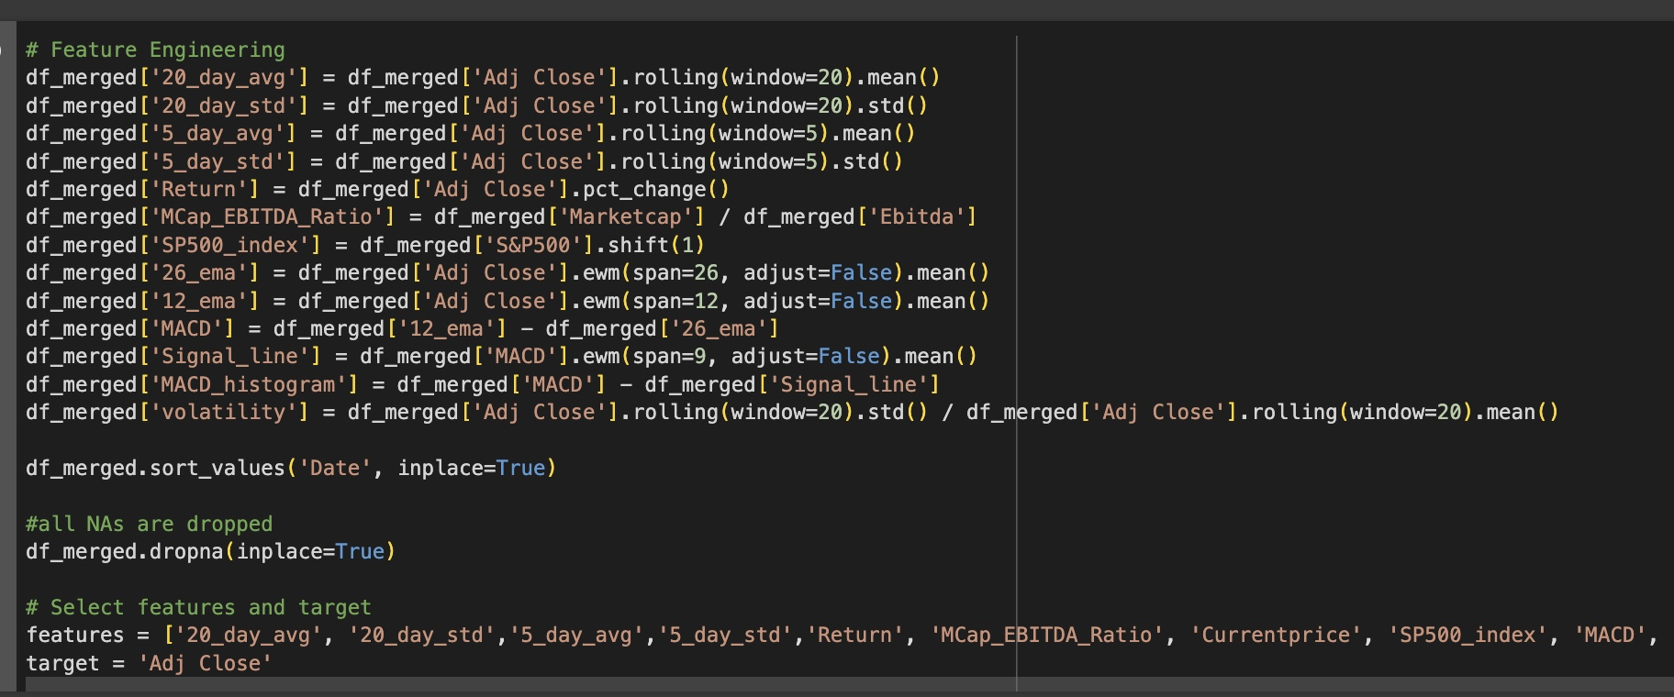
Feature Engineering Code
Top 10 companies in Market Cap

Slide 14
Data Scaling and splitting
Training Data 70%
Data Scaling: Before modeling, features are scaled using StandardScaler to ensure they contribute equally to the model's performance, important for models like Ridge and Lasso regression that are sensitive to the scale of input data.StandardScaler ensures that all variables contribute equally to the analysis by converting their values into z-scores.
Split Data: The data is split into training and testing sets (70% training, 30% testing). This split is essential for training the models on one set of data and testing them on unseen data to evaluate their predictiveness.
Testing Data 30%

Slide 15

Model Training
Linear Regression
Lasso Regression
Ridge Regression
Linear Regression is fundamental statistical model for modeling the relationship between a dependent variable and one or more independent variables by fitting a linear equation to observed data.I have used Linear Regression to predict the 'Adj Close' price of a stock based on various technical indicators and financial ratios.
Lasso Regression ensures no single factor feature in data shouts too loudly. It does this by applying penalty to each feature based on its influence on prediction. The bigger the influence, the bigger the penalty. If a feature's influence is too small, Lasso drops it to zero or ignores that feature completely. I have used alpha value of 0.1, suggesting moderate regularization. Since there are many features it can identify and eliminate non-informative features, simplifying the model and potentially improving generalization performance.
Ridge Regression is like linear regression, designed to make predictions more reliable. Ridge uses a technique where the penalty is based on the square of each features magnitude. This doesn't allow any of the feature to go to zero (like in Lasso).Ridge Regression is applied with an alpha value of 1.0, which controls the regularization strength.

Slide 16
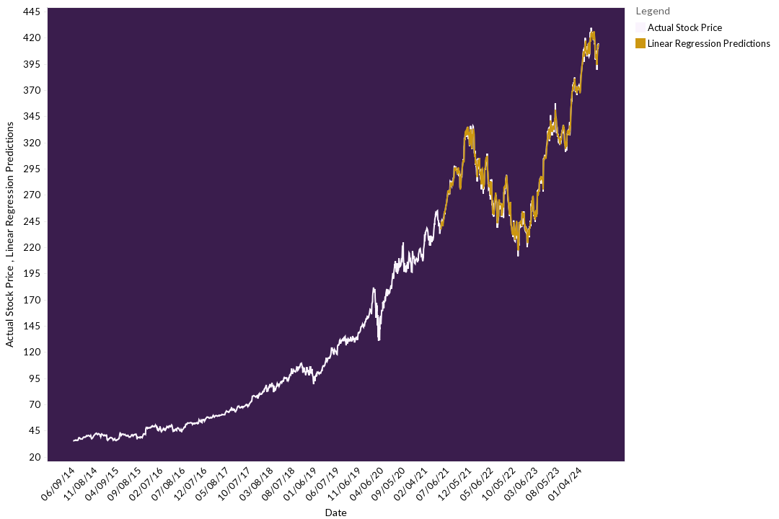
Linear Regression Model Prediction
Top 10 companies in Market Cap
Linear Regression Latest Prediction for next day:
Predicted: 413.52
Actual: 414.74

Slide 17
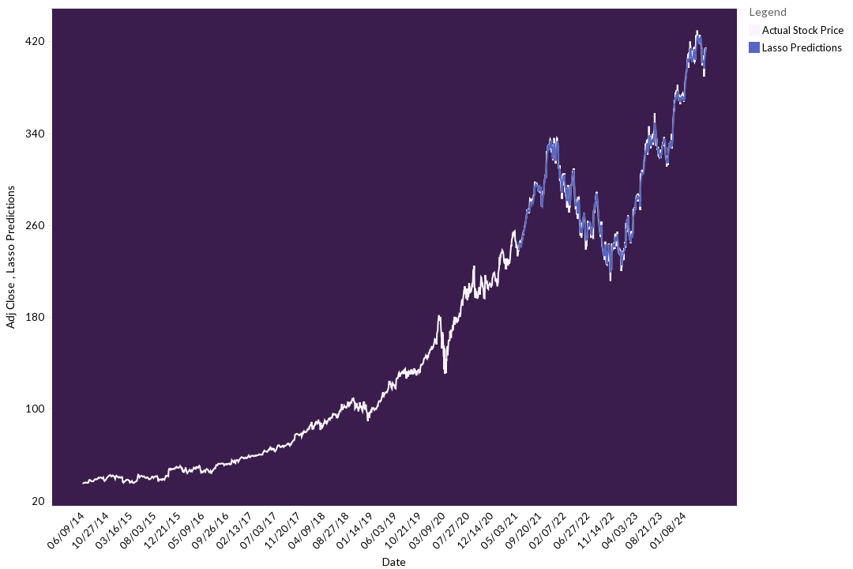
Lasso Regression Model Prediction
Top 10 companies in Market Cap
Lasso Latest Prediction for next day:
Predicted: 413.67
Actual: 414.74

Slide 18
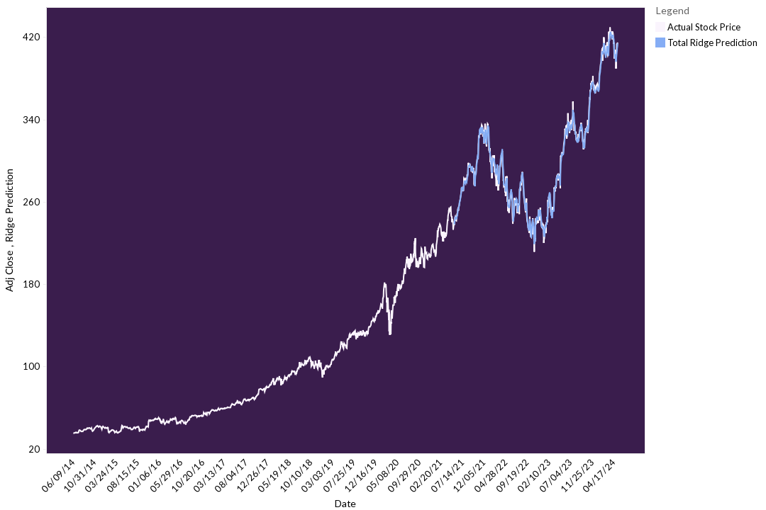
Ridge Regression Model Prediction
Top 10 companies in Market Cap
Ridge Latest Prediction for next day:
Predicted: 413.71
Actual: 414.74

Slide 19
Model Evaluation
Linear Regression
Lasso Regression
Ridge Regression
Model Ranking by Performance : Linear Regression > Lasso > Ridge.
Accuracy:
All three models predict quite close to the actual values (lasso and ridge predicted better than linear on this run).
But Linear Regression has the edge in both error metrics and the closeness of predictions on multiple iterations
MSE | 4.7936
MAE | 1.6987
RMSE | 2.1894
R^2 | 0.9983
MSE | 8.0264
MAE | 2.2098
RMSE | 2.8331
R^2 | 0.9972
MSE | 10.8377
MAE | 2.5212
RMSE | 3.2921
R^2 | 0.9962

Slide 20
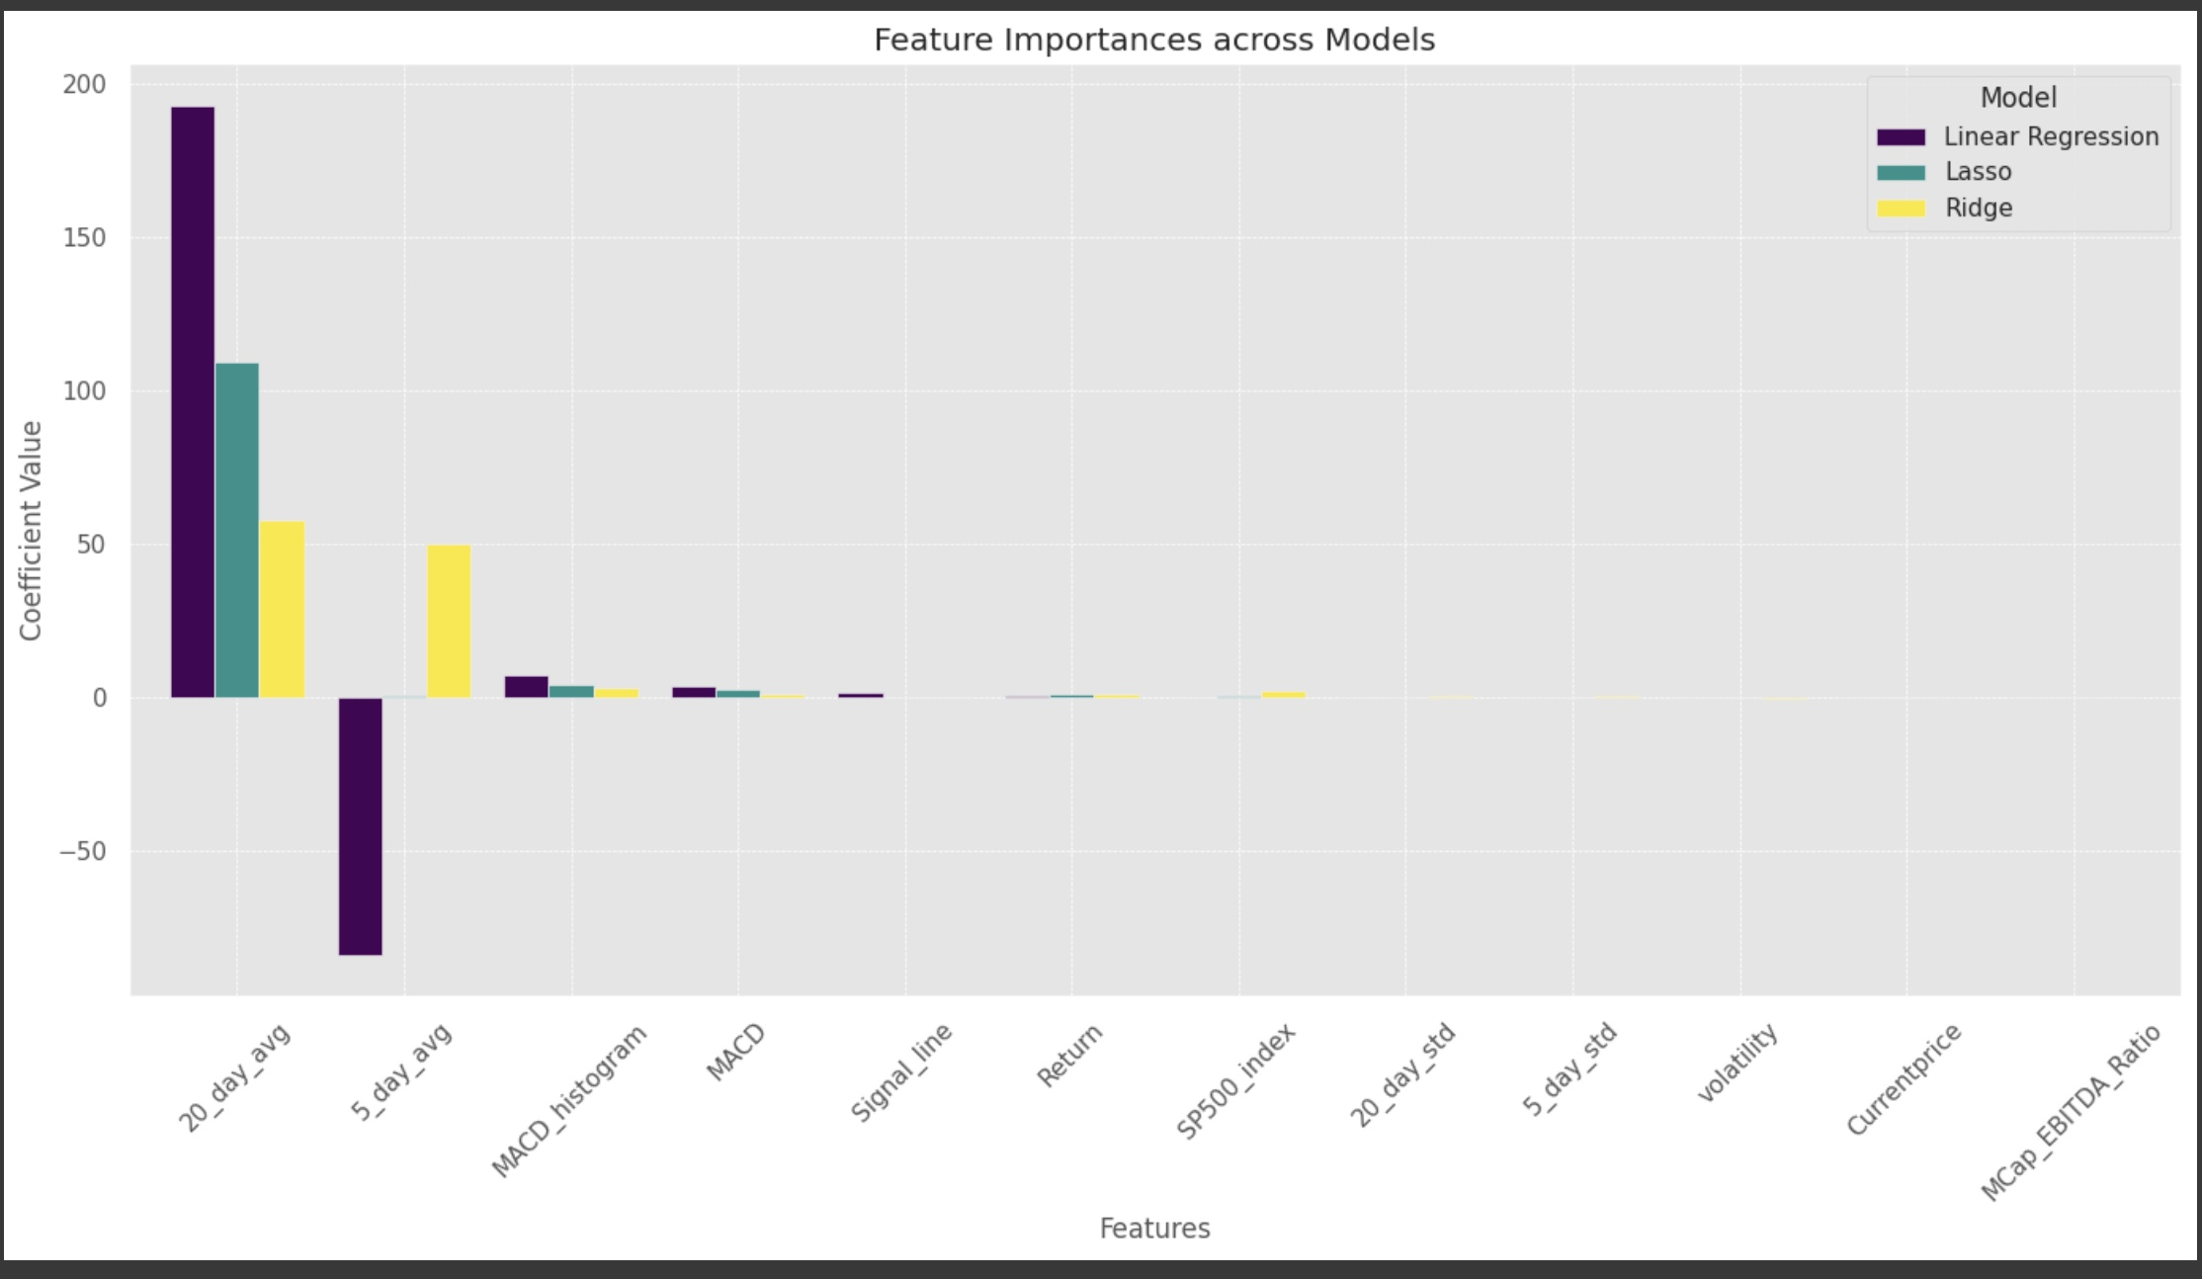
Important Features across models
Top 10 companies in Market Cap
20_day_avg , 5_day_avg, MACD are important features across models

Slide 21
THANK YOU
Pooja ChavanPatil

